Slide 1











Chukar Site Abundance Model
Chukar Site
Abundance
Negative Binomial Distribution
exp()
dnorm()
rate
C
Lambda2
log.r2
chuk.eps
Sage Grouse
Harvest (Wing-B)
theta
Hunter #’s Model
Total Harvest Model
Observed # of hunters
Observed Total Harvest
Dpois()
Birds per Hunter
Dpois()
Preliminary Hunter # Model
lambda1
$$\frac{H_{t+1}}{H_{t}}$$
# of Hunter $(H_{s,r,t})$
$$\frac{N}{H}$$
Total Harvest
($N_{s,r,t}$)
$$\frac{H_{t+1}}{H_{t}}$$
# of Hunter $(H_{t})$
$$rho$$
log()
$$rho$$
λ
$rho$2
lambda
$$ε_{t}$$
$$\frac{{Covariance}_{S1S2}}{\sqrt{SD\left(S1\right)×SD(S2)}}$$
log()
Exp()
$$\frac{{Covariance}_{S1S2}}{\sqrt{SD\left(S1\right)×SD(S2)}}$$
Spline
($β_{trend}$)
Multivariate Normal Distribution
$$\frac{{Covariance}_{S1S2}}{\sqrt{SD\left(S1\right)×SD(S2)}}$$
$$log.r$$
$$ε_{t}$$
Species
Covariance Matrix
(Sigma)
Multivariate Normal Distribution
Temporal Trends
${μ1}_{s,r,t}$ (hunters)
Species
Covariance Matrix
(Sigma2)
Multivariate Normal Distribution
Species
Covariance Matrix
(Sigma)
Hunting License Sales
$$μ_{s,r,t}$$
Regional Drought
Index (wpdsi)
Unemployment
Winter = wpdsi
Breeding= pdsi
${μ2}_{s,r,t}$ (harvest)
Unemployment
Spline
($β_{pressure}$)
Relative Cost
of Gas
Regional Drought
Index
Bbase()
Spline
($β_{trend}$)
Relative Cost
of Gas
Autoregression
Function
(ar1)
H
(hunter.prime)
Temporal Trends
Personal Disposable
Income (PDI)

Slide 2
Construct (conceptual) Model
Economic Conditions
Hunter
Effort
Birds per Hunter
Climate
Predator Abundance/
Ecosystem Conditions
Game Bird
Abundance

Slide 3
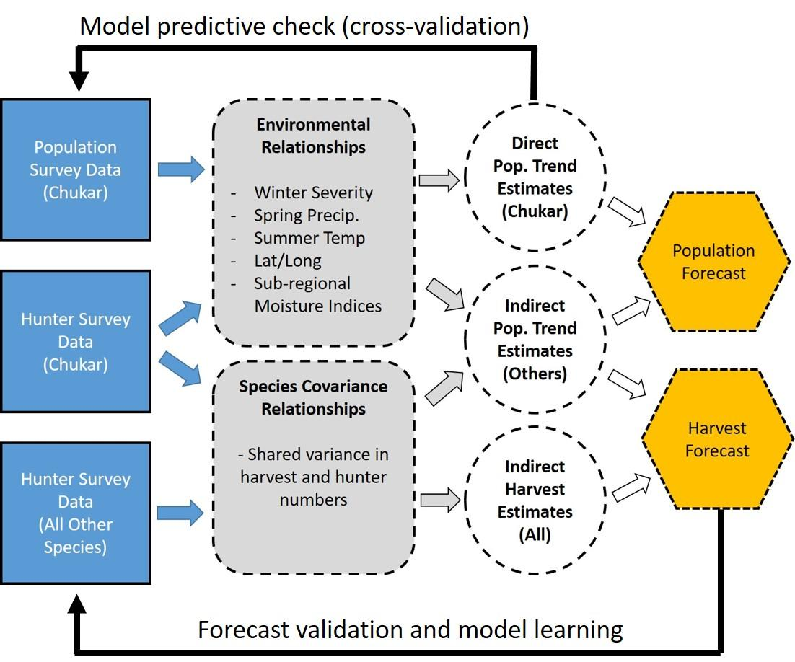

Slide 4
Construct (conceptual) Model
N₁
N₂
N…
N_{S}
Annual Hunter
Participation
(N_{s})
Economic Conditions
Hunter
Effort
Climate
Total
Harvest
(H_{s})
Predator Abundance/
Ecosystem Conditions
Game Bird
Abundance
H₁
H₂
H…
H_{S}

